Slide 1
Correlating Climate and Wildfire Data to Predict Wildfires in Colorado
Ankrit Uprety, Cole MacPherson, Connor Ely, Ryan Block

Slide 2
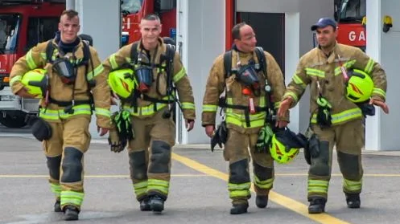
Team Members
Ankrit Uprety
(CSCI 4502) anup2318@colorado.edu
Cole MacPherson
(CSCI 4502) cole.macpherson@colorado.edu
Connor Ely
(CSCI 4502) connor.ely@colorado.edu
Ryan Block
(CSCI 4502) ryan.block@colorado.edu

Slide 3
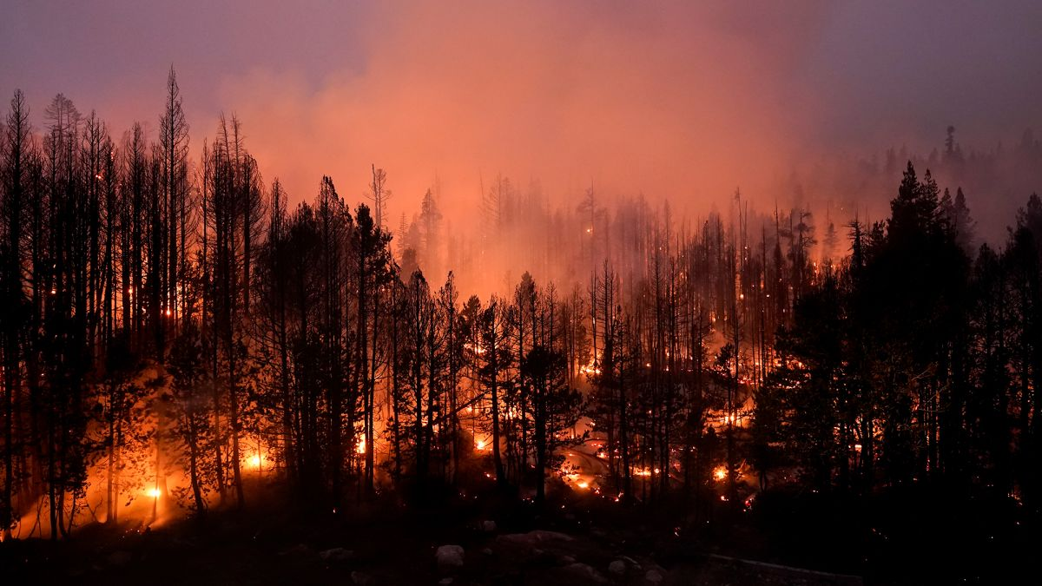
Introduction
Especially in recent years, wildfires have ravaged a large area of wilderness; specifically in the western United States.
This has had an effect on thousands of people, their homes, and their lives.
Our goal is to look at some of this data in an effort to predict when and where the next big blaze will occur.
If accurate predictions can be made, similar algorithms may be able to even save the lives of those closest to the areas.
Challenges include sorting through all of the relevant data and validating our model.

Slide 4
Related Work
National Park Service’s National Fire Danger Rating System
Level system (green through red)
Uses Relative Humidity, Fuel Moisture, Drought Index, Haines Index, Lightning Activity Levels
“A Data Mining Approach to Predict Forest Fires using Meteorological Data”
Cortez, Morals, 2007
(PDF) A Data Mining Approach to Predict Forest Fires using Meteorological Data (researchgate.net)
“Leveraging Machine Learning to predict wildfires using PyTorch Lightning”
Machine learning based approach to predict wildfires, local blog
Leveraging Machine Learning to predict wildfires using PyTorch Lightning | by Aishwarya Srinivasan | Towards Data Science
“Data-Driven Wildfire Risk Prediction in Northern California”
Malik et. al., 2021
Used data parameters such as powerlines, terrain, and vegetation in different perspectives to train a model that improved the spatial and temporal accuracy in predicting the risk of wildfire including fire ignition.

Slide 5
Proposed Work
A Colorado-centric approach to modelling the relationship between climate and wildfires.
Possible Datasets:
Drought Data
Historical Data and Conditions | Drought.gov
Weather Data
Custom Options - Daily Summaries | Climate Data Online (CDO) | National Climatic Data Center (NCDC) (noaa.gov)
Subtasks:
Collect all relevant climate, weather, and wildfire data.
Clean data to prepare for analysis.
Model the relationship between climate and wildfires to help make predictions.
Compare model to last 10 years of historical wildfire data to determine level of success

Slide 6
Evaluation
Compare model results to last 10 years of historical data
Find correlations between the weather and the wildfires
Accuracy
If predicted wildfire locations match historical wildfire locations with >50% accuracy in a year long time span, this project will be a success
Ideal output is a wildfire risk metric based on region

Slide 7
Milestones
By the end of week 9
Collect all relevant data
By the end of week 11
Have all data cleaned and ready for analysis
By the end of week 13
Have the analysis of the data completed
By the end of week 14
Have final correlation relationship between weather and climate completed
By the end of week 15
Finish the the final project report
Notes:
COLE PRESENTS THIS SLIDE

Slide 8
Resources
Historical Data and Conditions | Drought.gov
Where can I find historical humidity data? – Visual Crossing Weather
Custom Options - Daily Summaries | Climate Data Online (CDO) | National Climatic Data Center (NCDC) (noaa.gov)
(PDF) A Data Mining Approach to Predict Forest Fires using Meteorological Data (researchgate.net)
Leveraging Machine Learning to predict wildfires using PyTorch Lightning | by Aishwarya Srinivasan | Towards Data Science

